Slide 1
The EPFO or Employees' Provident Fund Organisation provides an online facility wherein employees can apply for EPF advance /Non Refundable Loans for various purposes, sitting at the convenience of home.
An EPFO subscriber can take EPF advance from its EPF deposits for purposes like, purchase/construction of house, repayment of loan, non-receipt of wage for 2 months, for marriage of self/daughter/son/brother, for treatment of family member etc.
However, to apply for EPF advance online an employee must have seeded his/her Aadhaar, bank account and PAN number to his UAN.
Applicable to employees who are un-exempted – Part of code 18734, 32271 and 18453.
No Documents are required to be submitted for availing these advances.

Slide 2
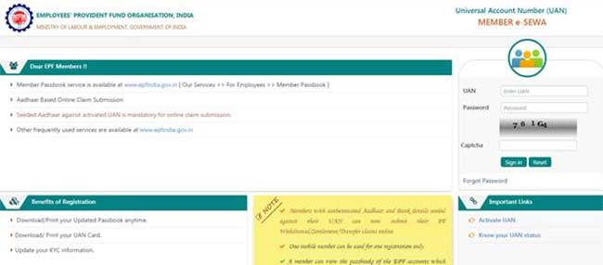
1) Log in to the EPFO members' portal using your UAN and password.

Slide 3
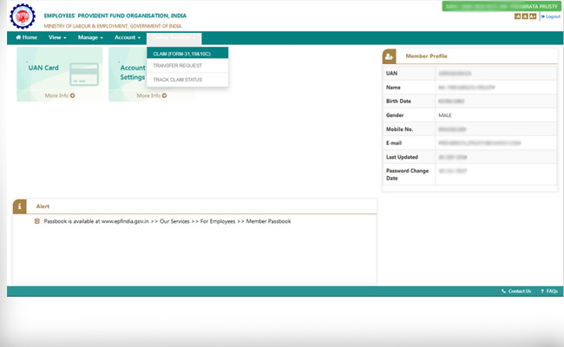
2) Go to the 'Online Services' tab on the main menu of the home page and select 'Claim' to generate an online request for advance.

Slide 4
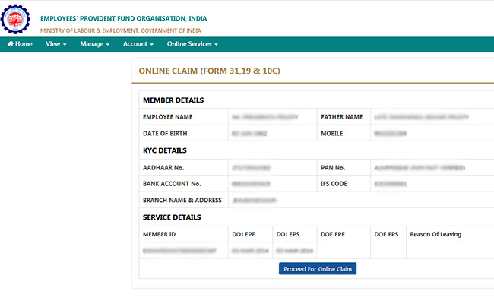
3) A new page will open showing all your personal details like name, father's name, date of birth, mobile number, Aadhaar number, PAN number, bank account and details, your date of joining of your company. If you find all the information is correct, click on "Proceed For Online Claim" tab to go ahead with online a advance claim

Slide 5
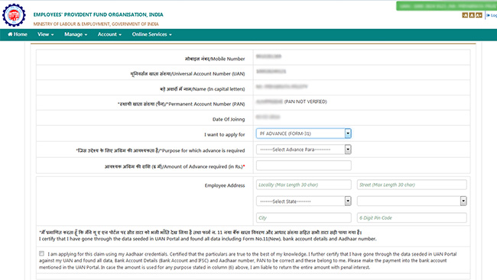
4) After you click on "Proceed For Online Claim" a new page will open. In the drop-down menu shown against "I want to apply for", select "PF ADVANCE
FORM 31.

Slide 6
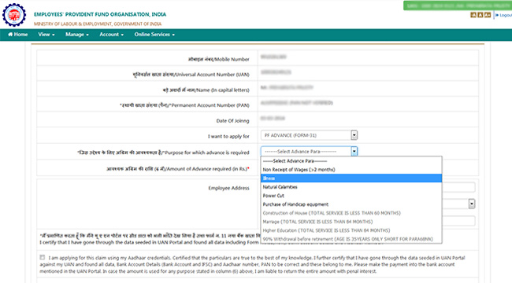
5) You need to fill the purpose for which the advance is required. Click on the drop-down menu where you will be shown all available advance options that you
are eligible for. You have to select the kind of advance (i.e non-receipt of wage, illness, natural calamities, power cut, purchase of handicap equipment) that
you want to apply for. In the next field, fill the amount you want as advance and give your current address.

Slide 7
After you fill the address details, you have to sign the disclosure by clicking on the left hand box on the bottom of the box.
Once you click on the box, "Get Aadhaar OTP" tab will be visible on the screen, which need to be clicked for generating an one time password to authenticate the online advance request.
You have to enter the OTP in the box provided below and click on "Validate OTP and Submit Claim Form" to complete the online EPF advance application process.

